Slide 1
ParseNet: Looking Wider to See Better
Wei Liu, Andrew Rabinovich, Alexander C. Berg
ICLR 2016 submission
Computer Vision and Pattern Recognition (cs.CV)

Slide 2
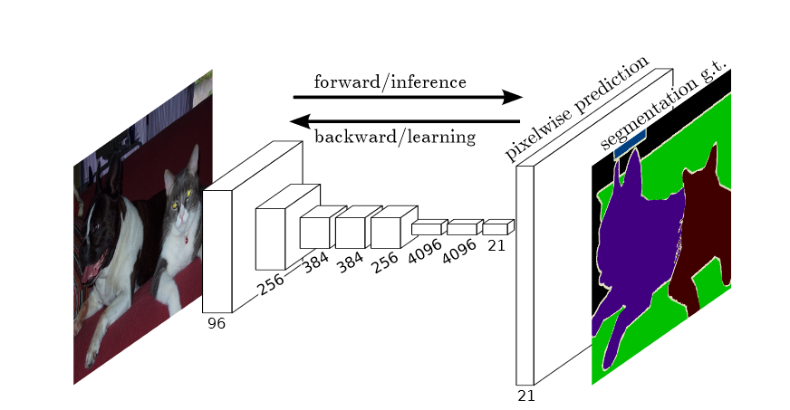
Fully Convolutional Networks
全卷积网络(FCN)的结构示意图

Slide 3
Pooling
上图显示池化如何应用于一个图像的四块不重合区域。

Slide 4
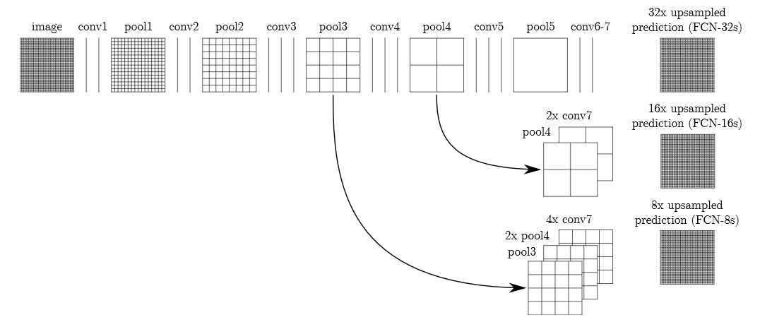
FCN UPSAMPLE
单击此处编辑母版文本样式
第二级
第三级
第四级
第五级

Slide 5
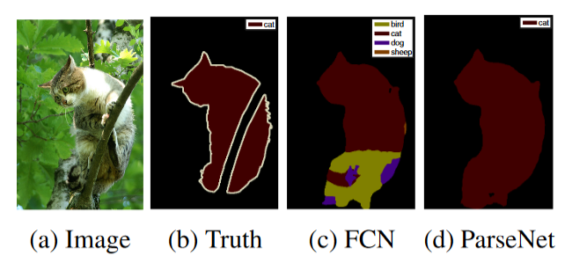
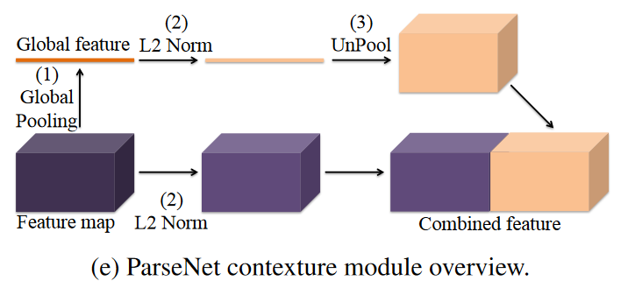
Global Context

Slide 6
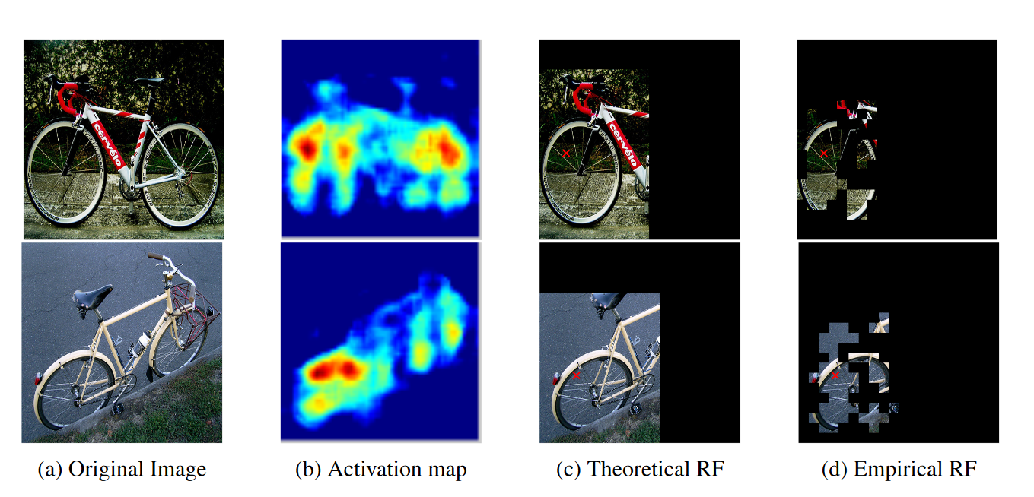
Receptive Field

Slide 7
Global Context = Looking Wider

Slide 8
Experiments
VOC2012
PASCAL-Context
SiftFlow

Slide 9
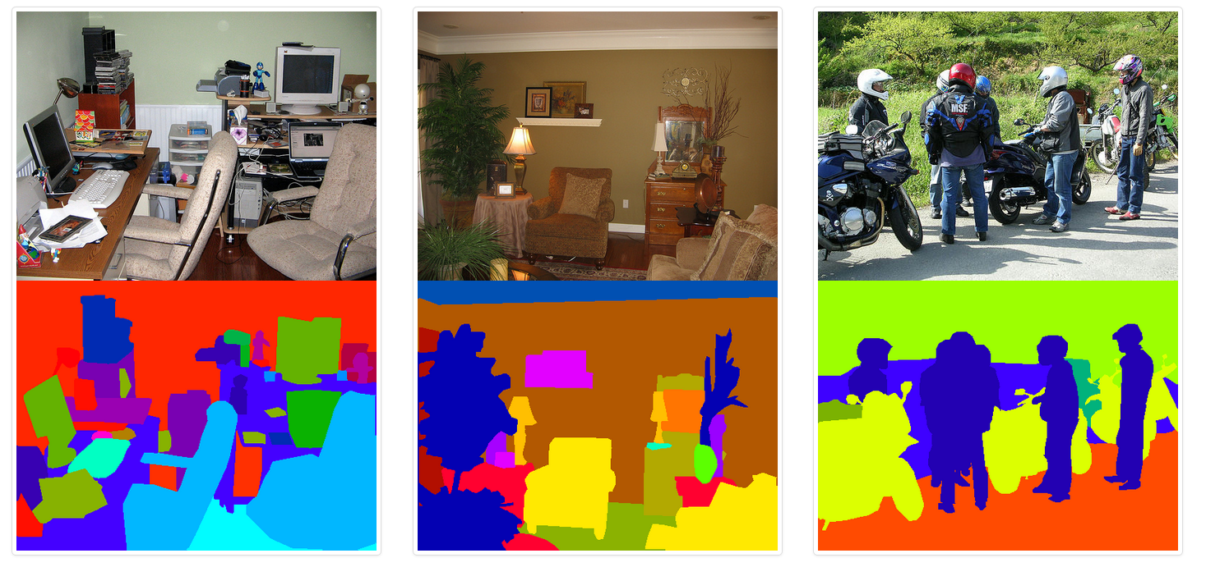
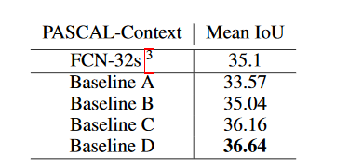
PASCAL Context dataset

Slide 10
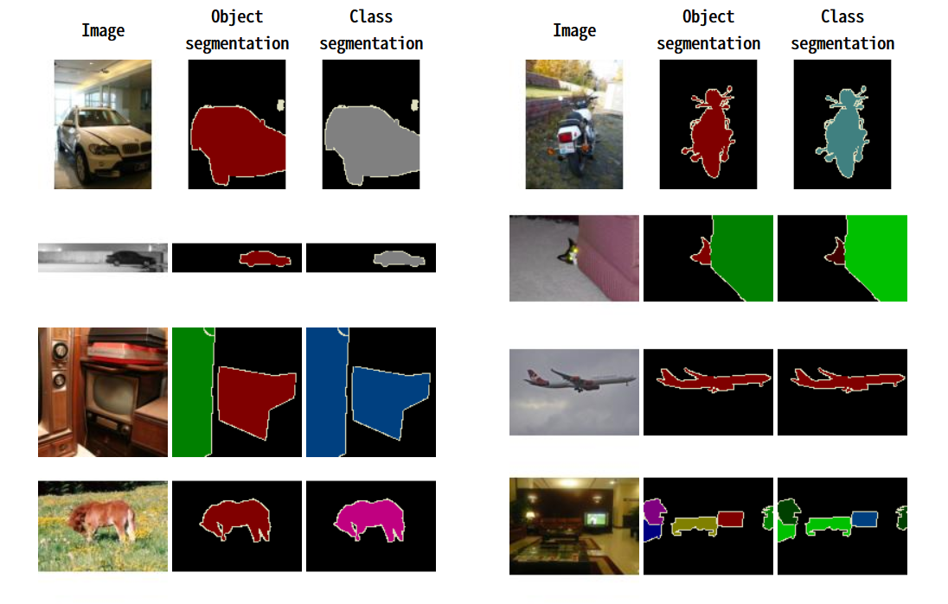
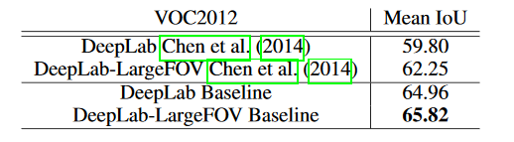
PASCAL VOC 2012 dataset

Slide 11
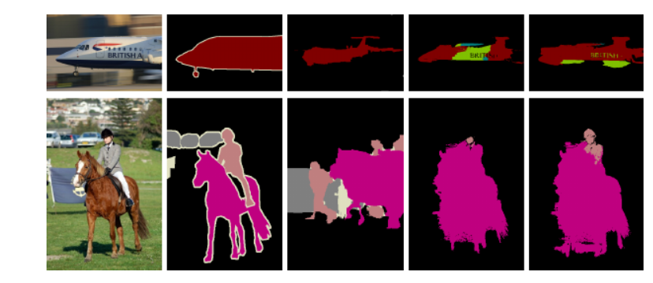
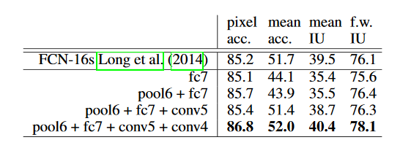
SiftFlow dataset

Slide 12
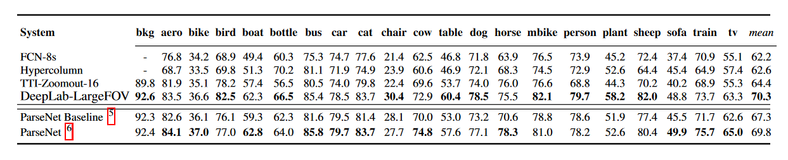
result

Slide 13
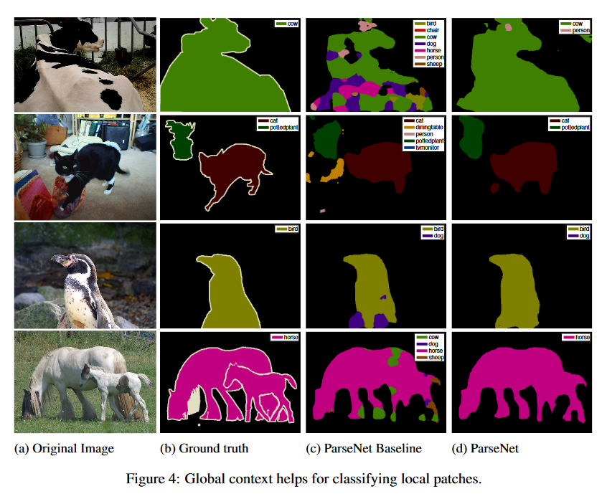
Global Context helps for classifying local patches

Slide 14
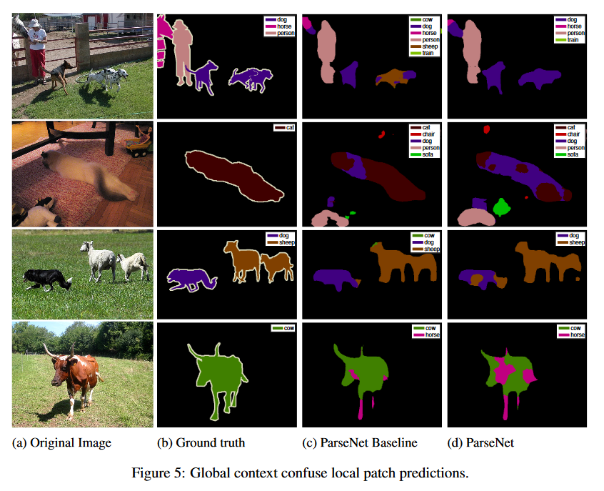
Global Context confuse local patch predictions

Slide 15
Conclusion

Slide 16
参考资料
Fully Convolutional Networks for Semantic Segmentation（ Computer Vision and Pattern Recognition (CVPR), 2015 IEEE Conference on）
http://ufldl.stanford.edu/wiki/index.php/Pooling
http://host.robots.ox.ac.uk/pascal/VOC/voc2012/

